Slide 1


Video Conferencing Interoperability for Legal Services
Spend more time with clients,
fewer managing meetings

Slide 2
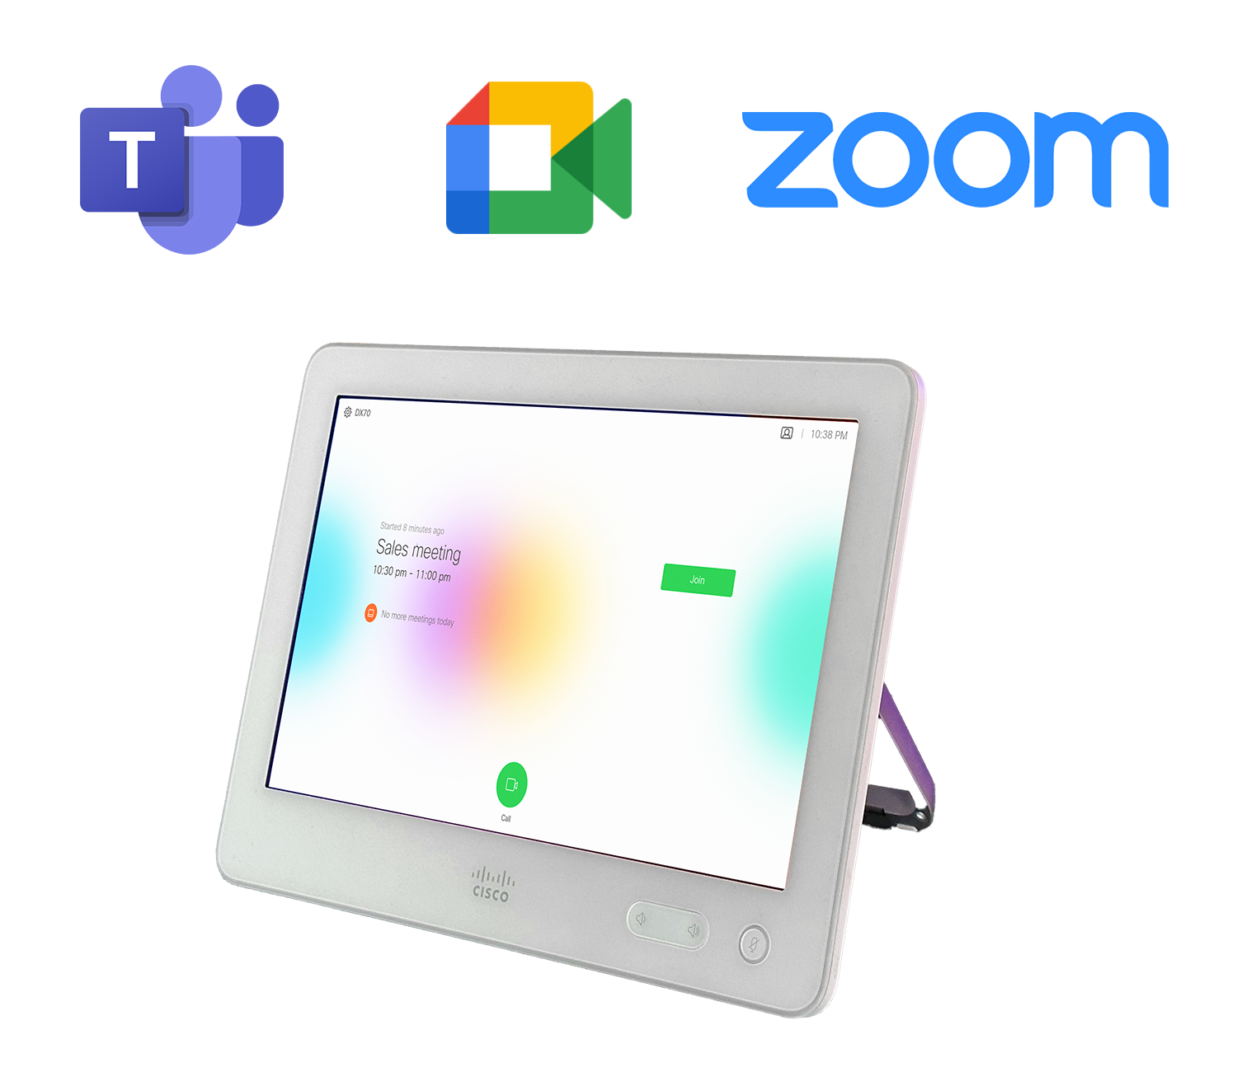

Synergy SKY CONNECT
Any SIP endpoint to all Web meetings Interoperability
Video Conferencing management and reporting
Optimization and scheduling for Meeting Rooms

Slide 3








Synergy SKY Certifications, Partnerships and Awards
ISO/IEC 27001:2013 certified
GDPR compliant (EU Regulation 2016/679)
Patented - Synergy SKY CONNECT
Cisco Solutions Plus Partner & WebEx Compatible. And available in Webex App Hub
Microsoft Partner and available in Azure marketplace
Winner of the Frost & Sullivan Product Innovation Award 2022
Synergy SKY® Registered Trademark

Slide 4
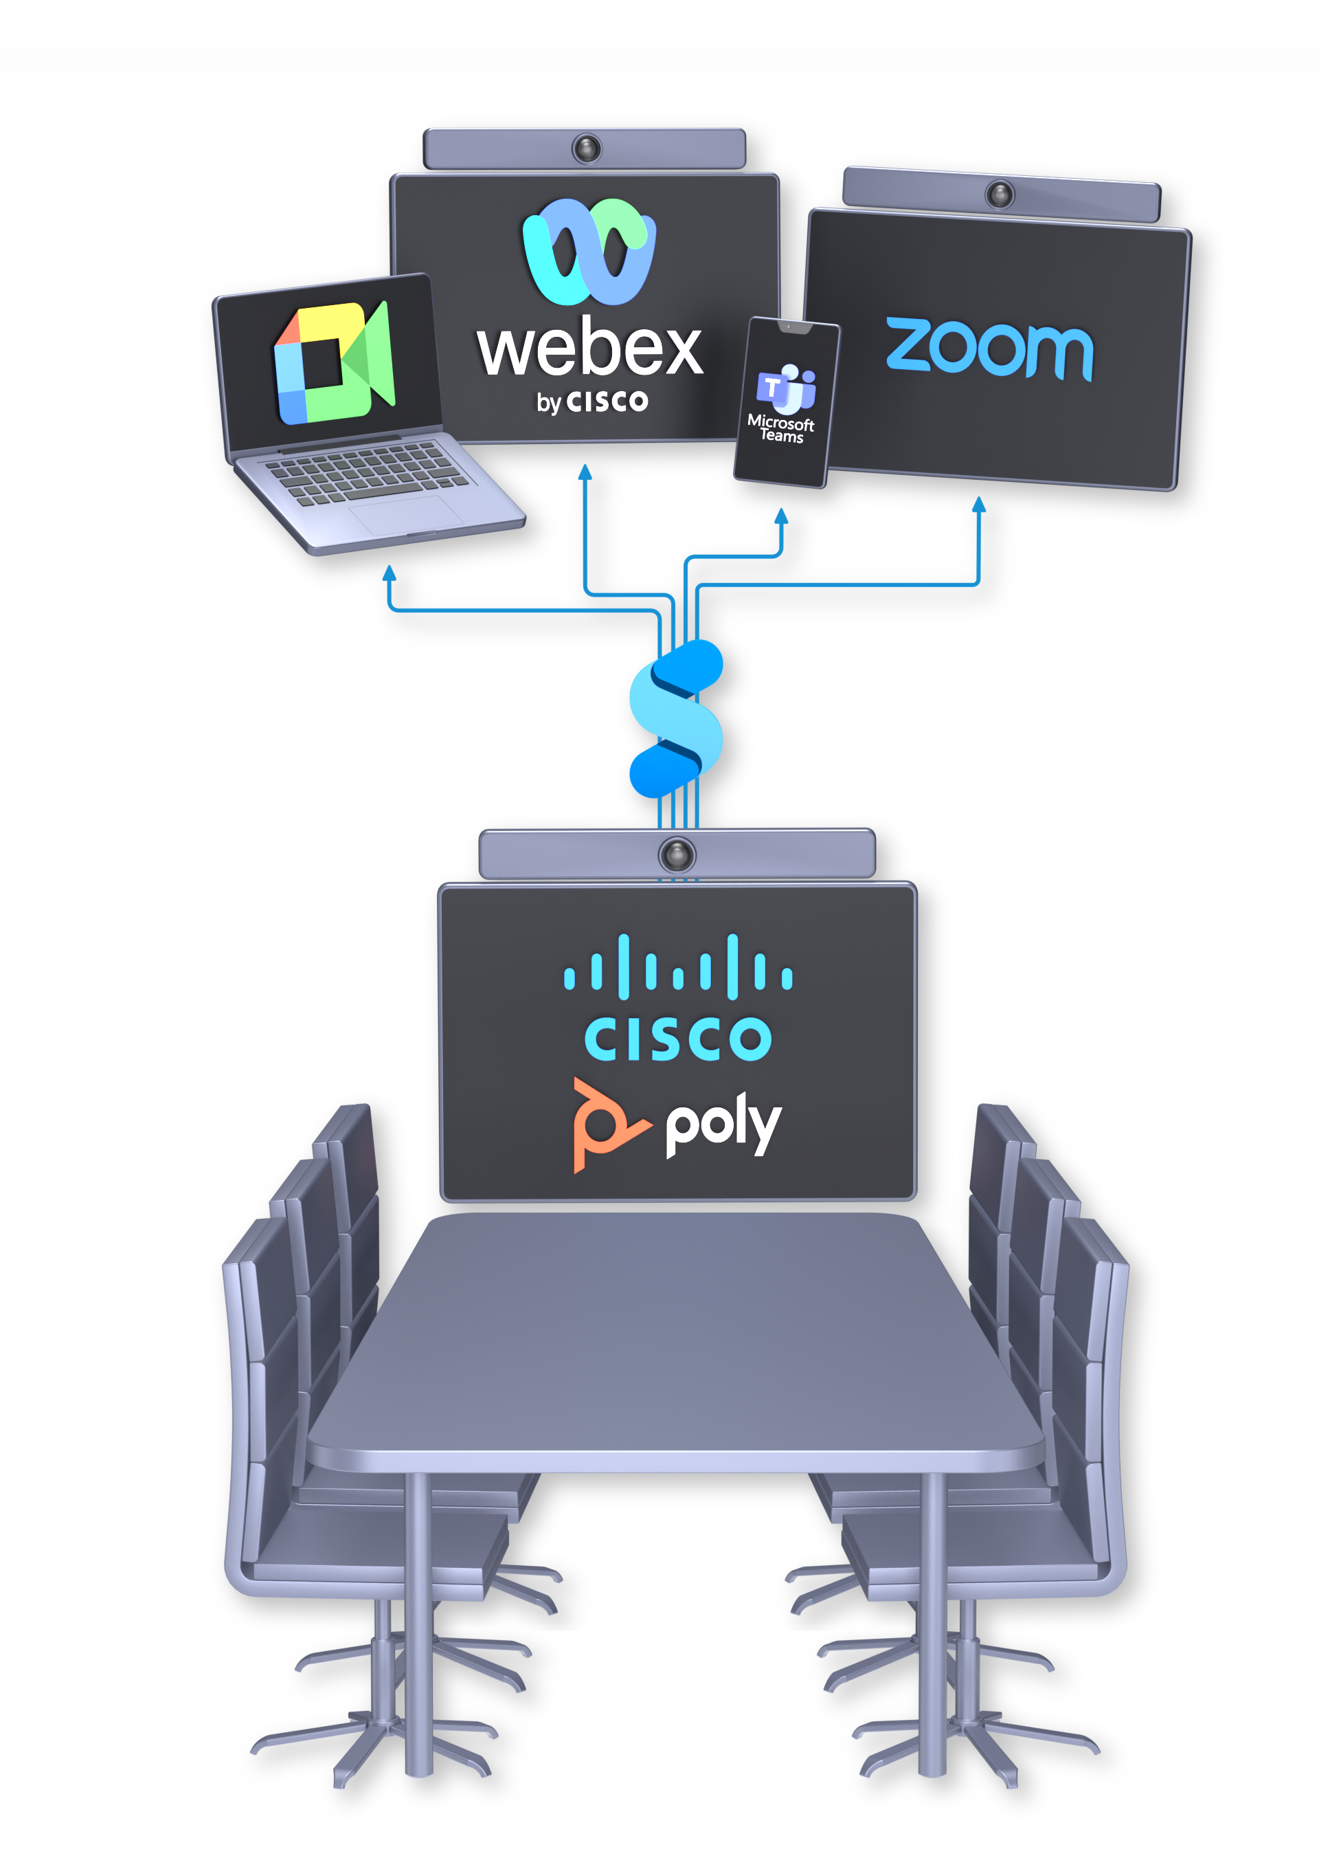
One service for your video rooms
With Synergy SKY your SIP video device get:
Interoperability
Control
SIP registering
It works regardless of the type and model of devices, making it a sustainable solution.
CONNECT provides an easy way to optimize existing setups without the need for any user training.

Slide 5
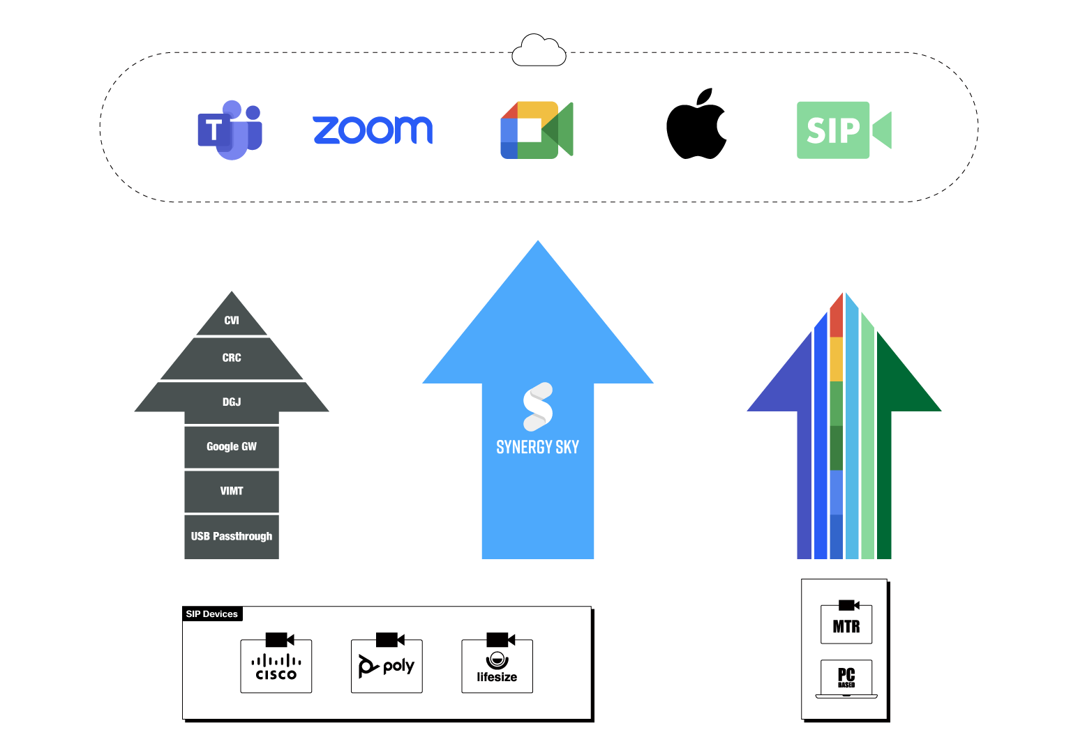

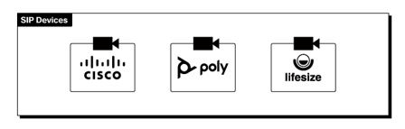
One service
Synergy SKY service is an all-in-one service for your videoconferencing devices. No need for any other.
Synergy SKY has a unique offering:
One workflow
One experience
One license
For all meetings

Slide 6
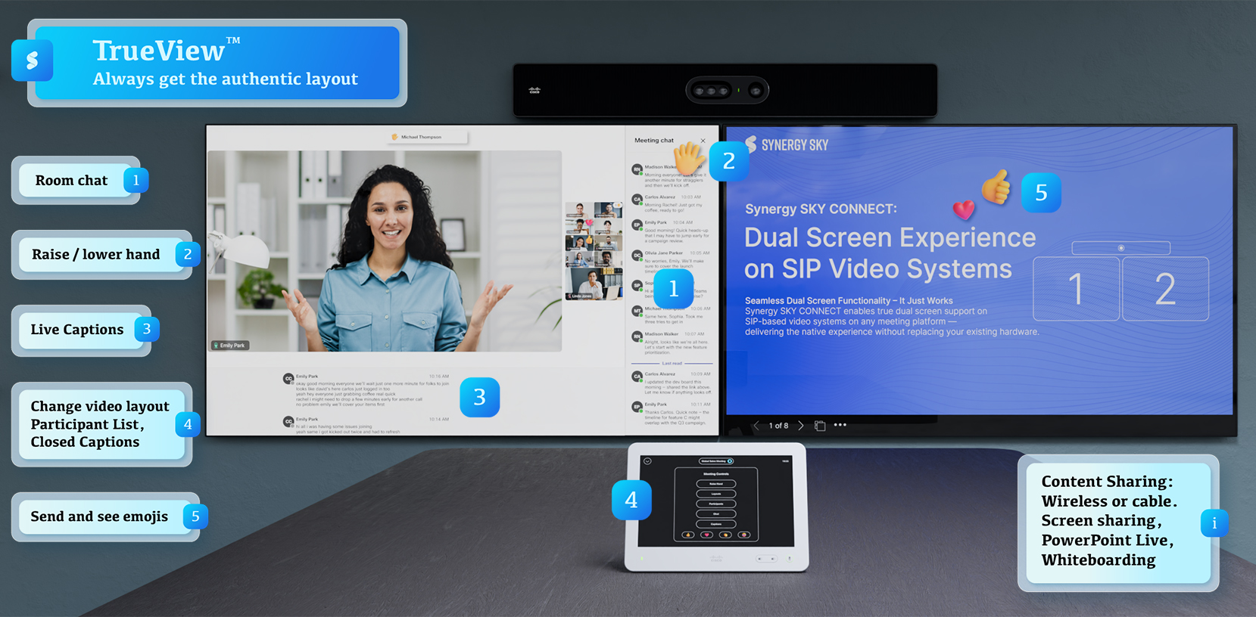
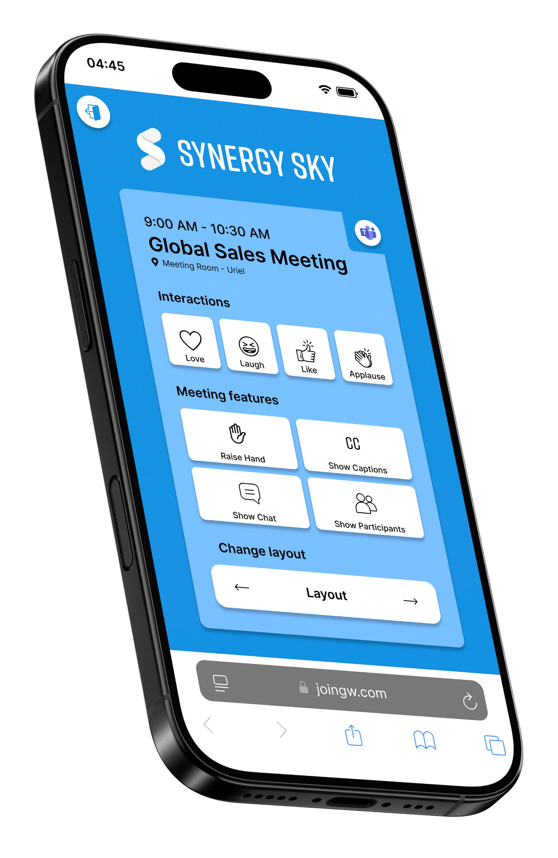
TrueViewTM
The Authentic Web Meeting Experience — On Any SIP Video Device Experience Microsoft Teams, Zoom*, Google Meet, and Webex exactly as intended — reliably and consistently across all SIP systems.
All features available in all meetings with Synergy SKY
On Cisco Touch
Touch panels like AMX, Crestron etc using DTMF integrations
On your smartphone by scanning QR code

Slide 7


Synergy SKY is the silent enabler of secure, compliant, and effortless video collaboration in the legal world — bridging conference rooms and web meetings (Teams, Zoom, Google) while meeting the sector’s strict privacy and reliability demands.

Slide 8
5 instant video conferencing benefits for your law firm
Join Teams, Zoom, Google Meet, Webex, and FaceTime meetings from your Cisco or Poly rooms
Transform existing video rooms into multi-platform meeting spaces without replacement
Start every meeting on time with one-click JOIN, eliminating billable time waste
Share presentations bidirectionally, including PowerPoint Live and whiteboarding
Get native meeting experiences with layouts, participant lists, and in-room controls

Slide 9



Make your video meetings easy for everyone
Lawyers/Attorneys
Office Administrators
IT Specialists
Join every meeting on time
Spend less time planning, scheduling, and managing meetings
No more complex video conferencing challenges

Slide 10
Thank You

