Slide 1
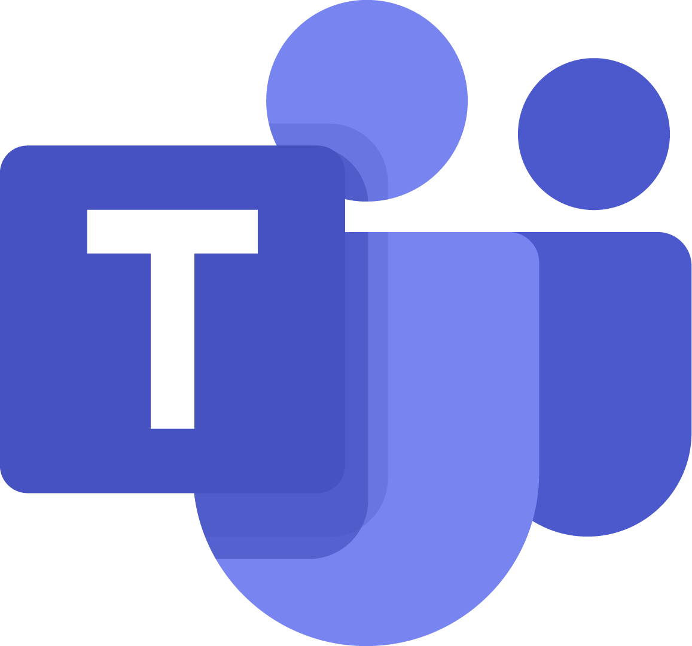

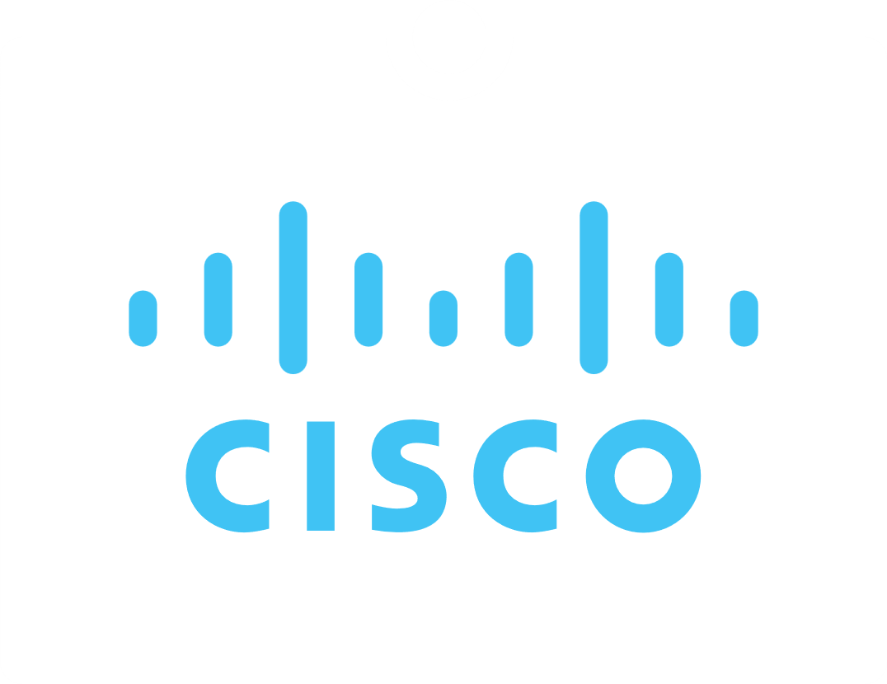
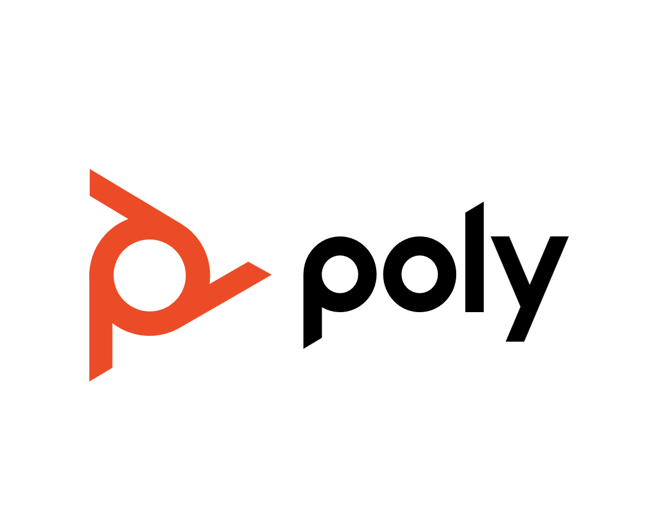
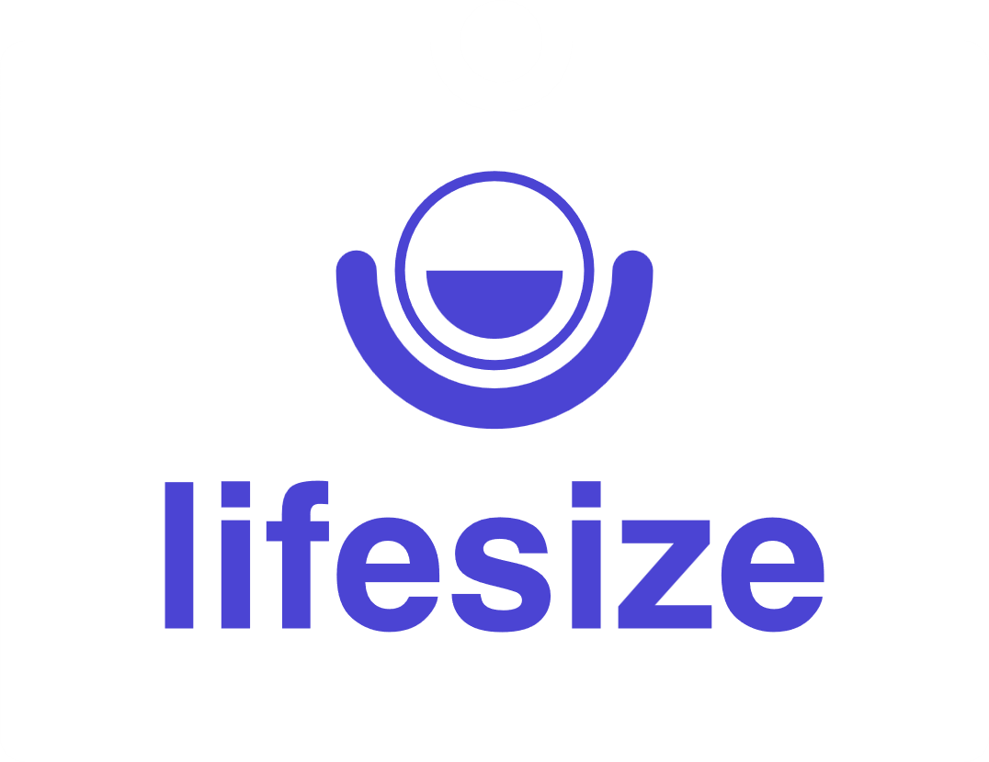
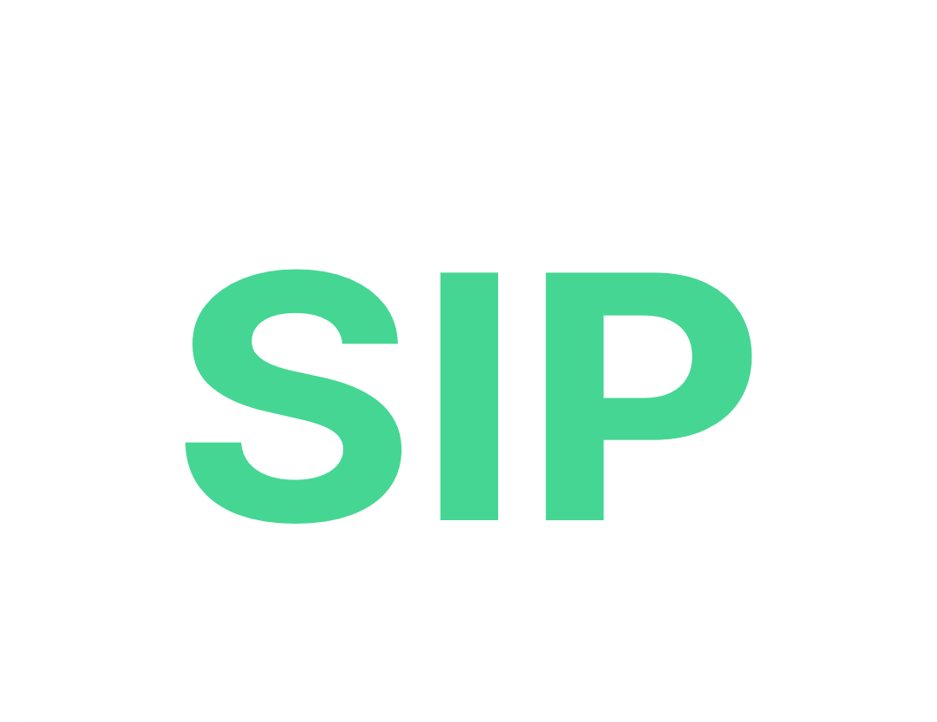


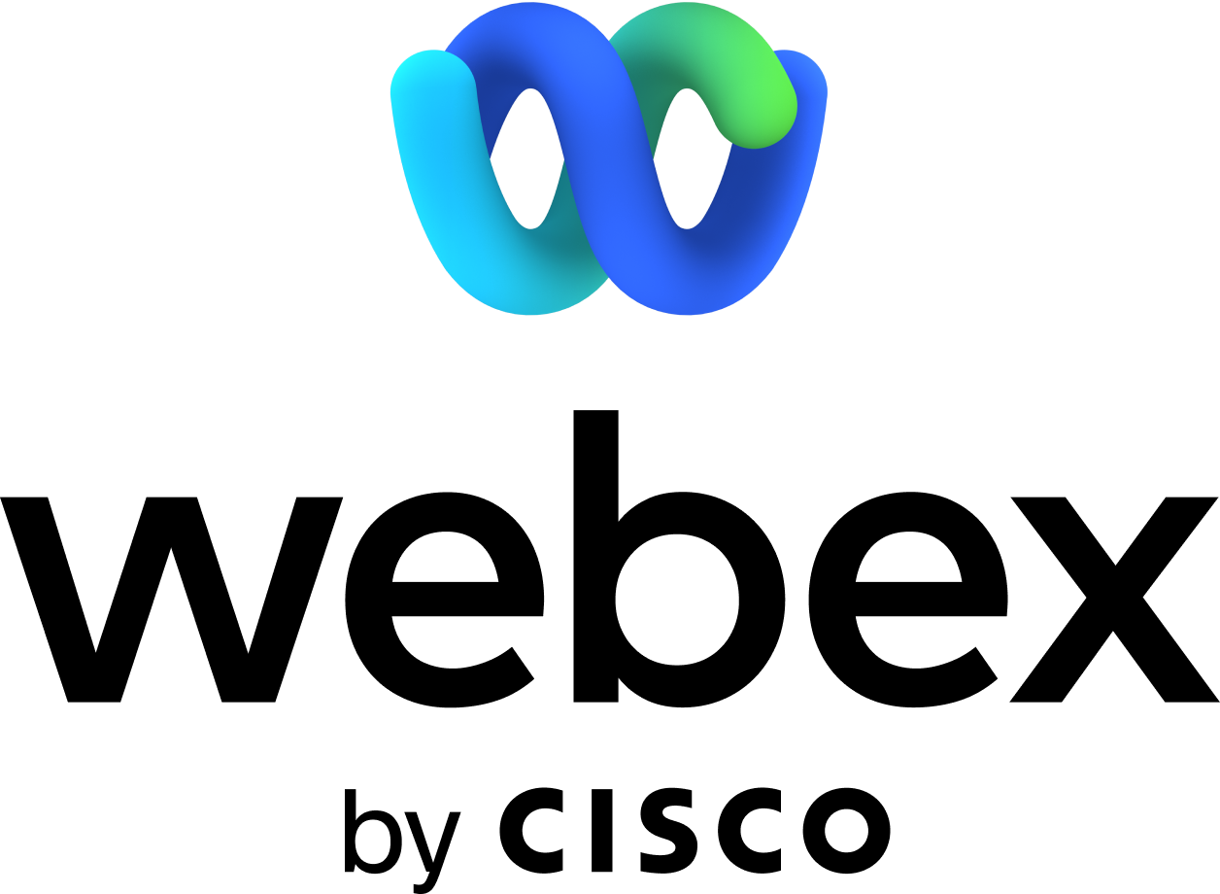














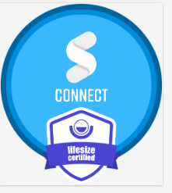

Video Collaboration That Meets Legal Standards
For our resellers: Use the customizable Synergy SKY one-pager whenever you need it! You can edit it in PowerPoint and share it as a PDF.
Questions? Email contact@synergysky.com.
Connect any SIP device to any meeting
Synergy SKY CONNECT is trusted by 20 of the top 100 U.S. law firms, Synergy SKY makes cross-platform video meetings simple to schedule, join, and manage.
Spend less time troubleshooting and more time on what matters — your clients
How Law Firm Video Conferencing Enhances Client Communication
Simplifies the process for legal teams to join external client and court meetings on any platform
One-button joining for Microsoft Teams, Zoom, Google Meet, FaceTime, and other platforms from your Cisco/Poly/Zoom endpoints.
Reliable meeting connections that reduce technical interruptions during critical client consultations
Maximizes existing video equipment investments while supporting increased remote collaboration
Provides a solution for the Safelink URL rewrite issue, which strips SIP URIs from external meeting invitations
Certifications, Partnerships and Awards
Synergy SKY has a global reseller partner network
Partnerships with Cisco and Microsoft. Available in Azure MarketPlace and Webex Control Hub
CONNECT is a standards-based and patented interoperability solution
By adhering to ISO 270001 you know we can be a trusted partner

Slide 2
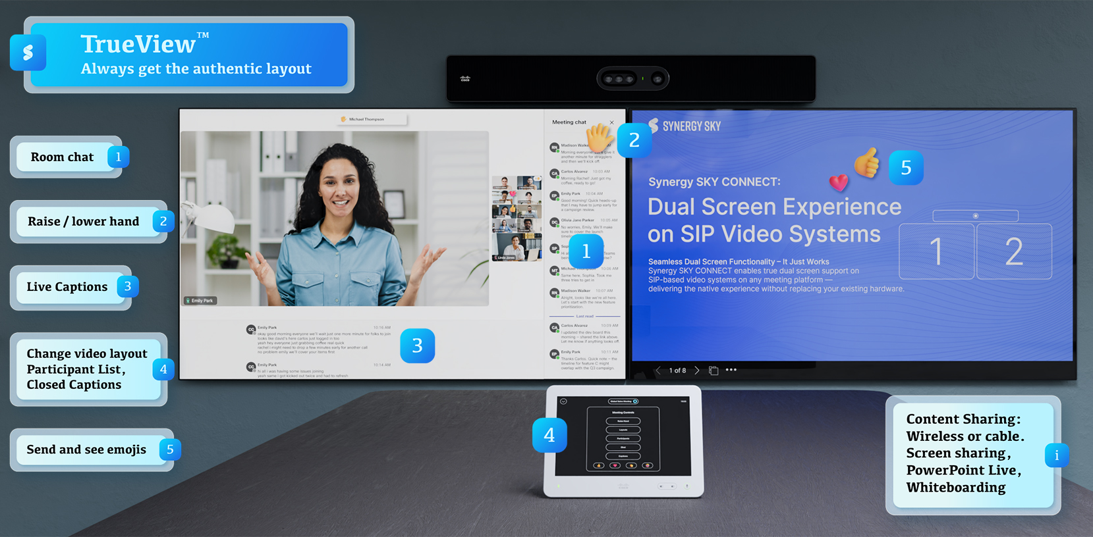






Key Features
Meeting Interactions from SIP devices in all meetings:
    Raise hand, Change Layout, Participants list, Open Chat pane, Send and See Emojis 💖👍
    Live Captions (CC) in Teams, Zoom and Google meetings
TrueViewTM - the native layout experience from web meetings on SIP video conference devices.
Flexible Meeting Access
Federal Compatibility
Unique In-Meeting Features
Easy Join: One Button to join all scheduled meetings.
Join-by-Id: Join any meeting by entering the native meeting Id.
CONNECT GO; Scan, Swipe, Connect from your cell phone.
Lobby Auto Admit in Teams, for approved SIP devices
Any Microsoft Teams environment:
Microsoft Cloud for US Government L2, L4 and L5 (DOD)
Cross environment and tenant compatibility
Utilized and trusted by US agencies
Developed and Deployed according to applicable STIG requirements
Partner to fill inn quotes etc
"Synergy SKY has been a game changer. The ease of use and fewer problems have transformed how we handle video conferencing.“ Columbia Distributing
“Since implementing Synergy SKY, it's hard not to smile at the positive user feedback!“
Build a Bear

Slide 3
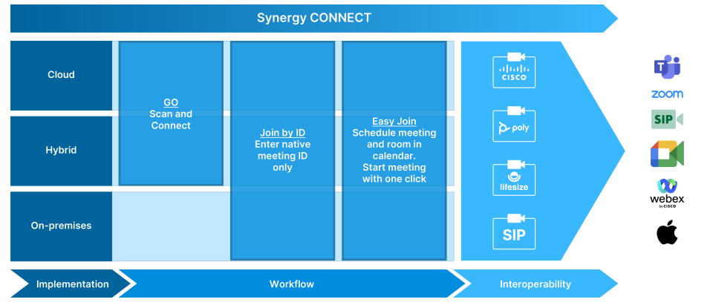

CONNECT deployment models
Workflow
Calendars supported Easy-Join / Join by Id: CONNECT GO: | Microsoft Calendar: Exchange on-premises. Microsoft 365, and Microsoft 365 for US Government L2, L4 and L5 (DOD) Google Calendar: Commercial and Federal Microsoft 365
Endpoint compatibility Easy-Join: Join by Id / CONNECT GO: | All Cisco, One Button To Push (OBTP) and Poly, One Touch Dial (OTD) All SIP devices from Cisco, Poly, Huawei, Yealink, Lifesize All Zoom Rooms; Neat, HP Poly, Logitech, Lenovo etc.
Interoperability
Endpoint compatibility | Compatible with all SIP video conferencing devices. Works seamlessly with leading systems from Cisco, Poly, Huawei, Yealink, LifeSize, and more.
Bandwidth support | Up to 6000kbps
Resolutions/frame rate | Up to 1080p30 fps
Video standards | H.264
Audio standards | G.711, G.722, Opus 8 - 48kHz
Protocols | SIP, SRTP/SRTCP, RTP/RTCP
Encryption | TLS, AES
Get Started Today
Partner to complete
Web address etc

